Slide 1
COMPUTER FUNDAMENTALS
.
A 1.1 .8 Compression

Slide 2
A 1.1.1 The CPU
Inquiry Statement : Describe the concept of compression.
Skills
Students will be able to analyse data and identify opportunities for compression using different techniques.
Students will be able to evaluate the suitability of different compression methods for various data types and applications.
Students can apply compression techniques to real-world examples and analyse the results.
ATL (Approaches to Learning) Skills
Communication: Students will effectively communicate their understanding of compression concepts through discussions, presentations, and written explanations.
Collaboration: Students will work collaboratively in groups to analyze data, apply compression techniques, and evaluate the results.
Critical Thinking: Students will analyze the trade-offs between compression ratio, data quality, and processing requirements. They will also evaluate the ethical implications of data compression in different contexts.
Creativity: Students will explore creative applications of compression techniques and potentially design their own simple compression algorithms.
Information Literacy: Students will effectively use online resources and research to deepen their understanding of compression algorithms and their applications in various fields.
Reflection: Students will reflect on the impact of compression on their daily lives and how their understanding of compression can inform their choices as consumers and users of technology.

Slide 3


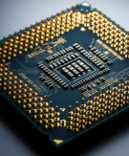


Do Now Activity (5 mins)
Identify the and explain the
Components of Computer
TOK
To what extent can data manipulation be considered an objective process when human judgment influences how databases are designed and interpreted?
Success Criteria:
Students will be able to explain the concept of pipelining and how it improves CPU performance.
Students will be able to describe the four stages of pipelining (fetch, decode, execute, write-back) and their functions.
Students will be able to explain how pipelining works in multi-core architectures, where each core has its own pipeline.
Students will be able to describe how cores in multi-core processors operate independently and in parallel
Learning Intention:
Describe the concept of compression.

Slide 4
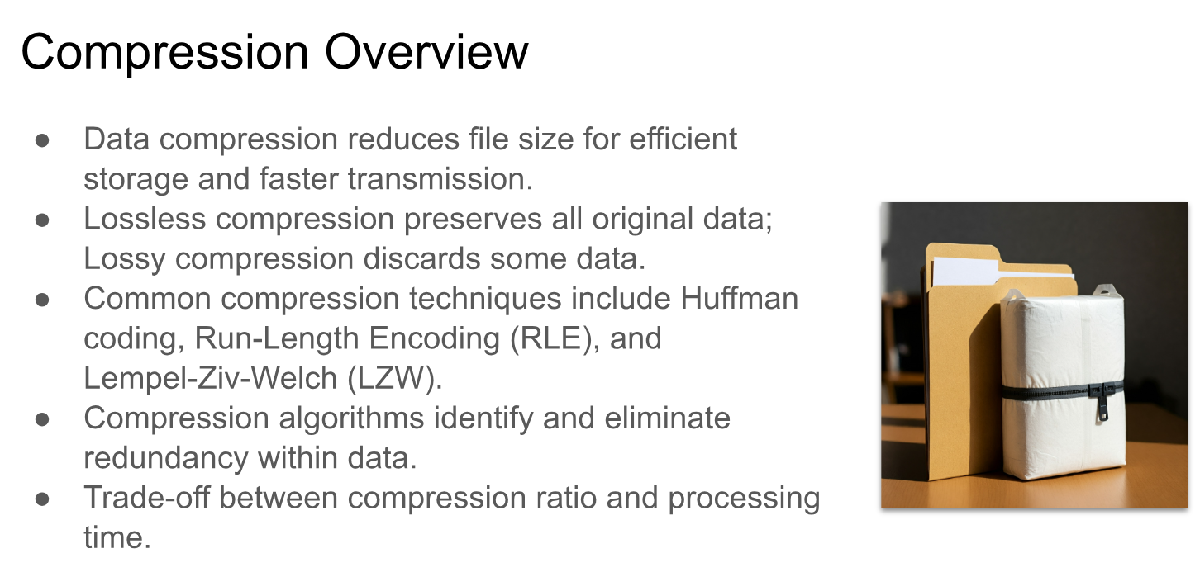

Slide 5
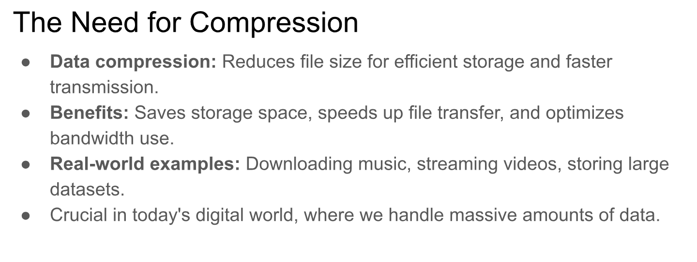

Slide 6
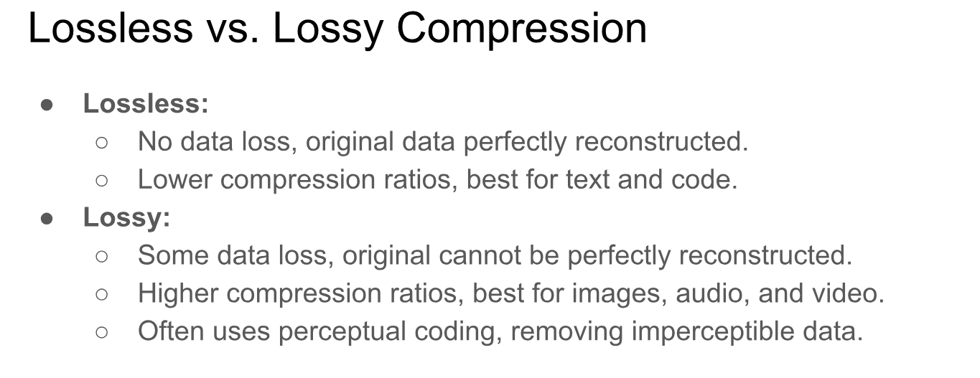

Slide 7
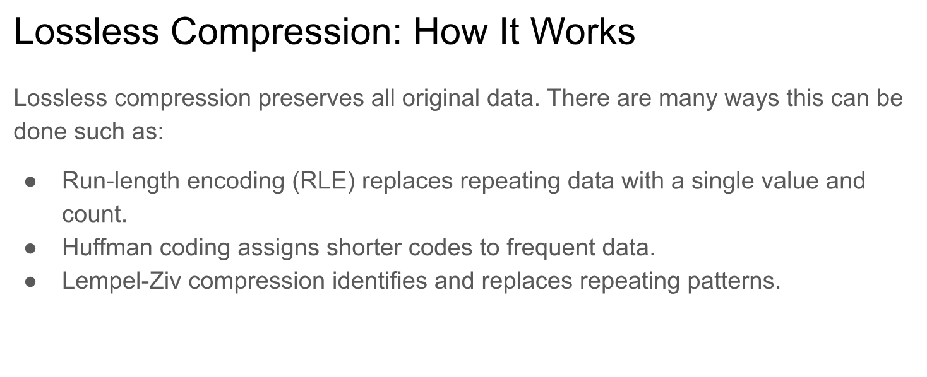

Slide 8
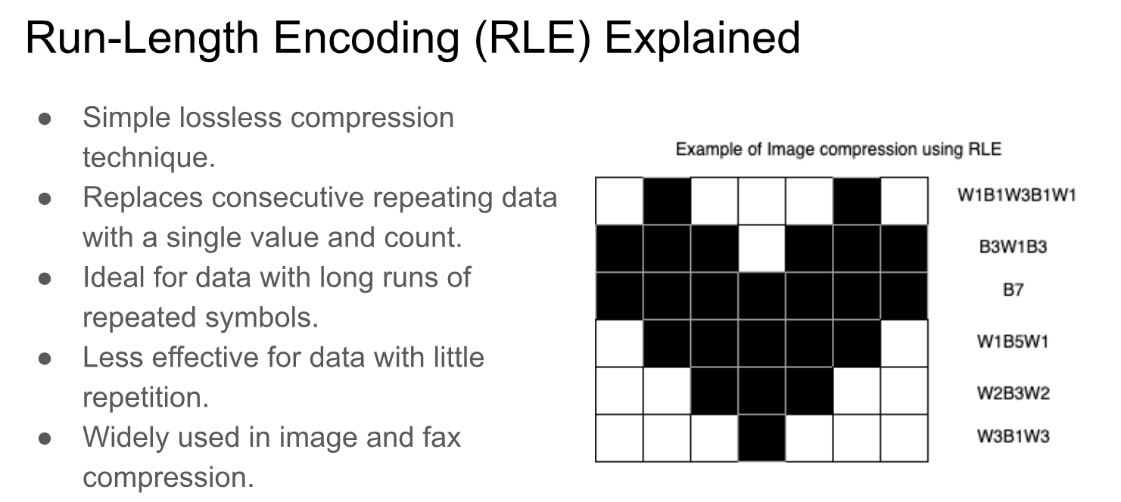

Slide 9
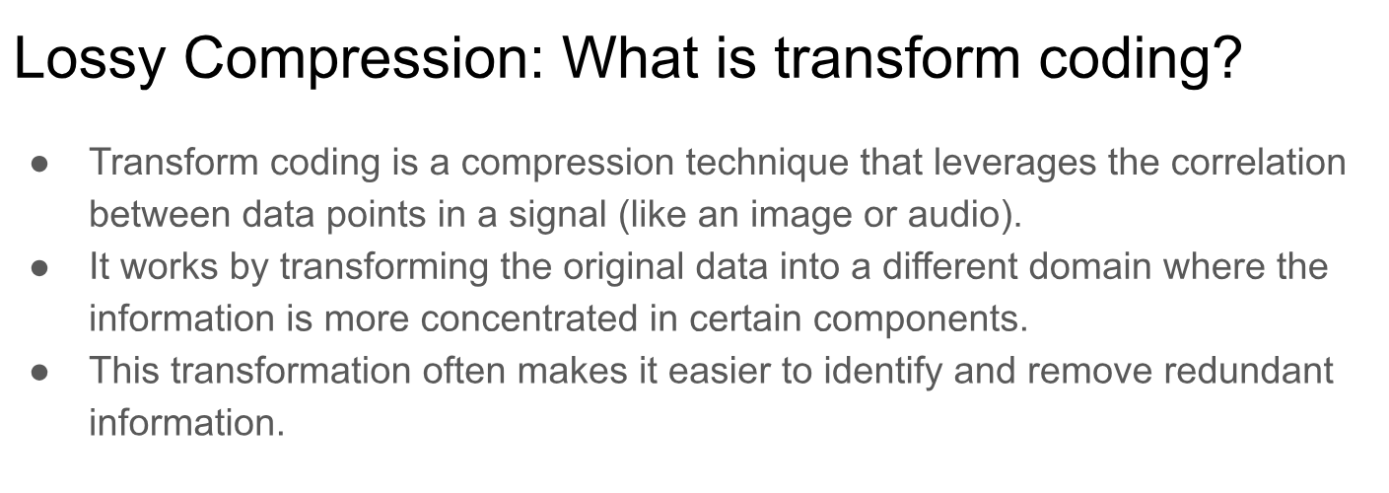

Slide 10
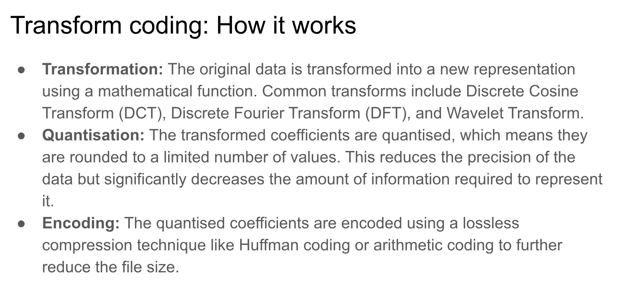

Slide 11
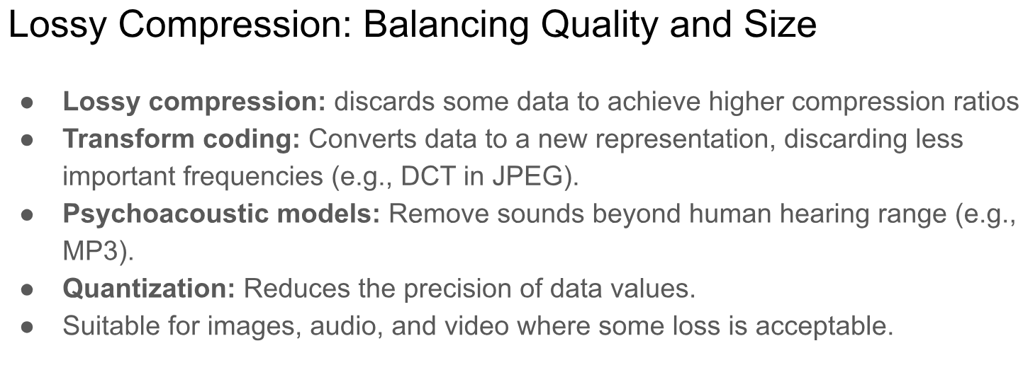

Slide 12
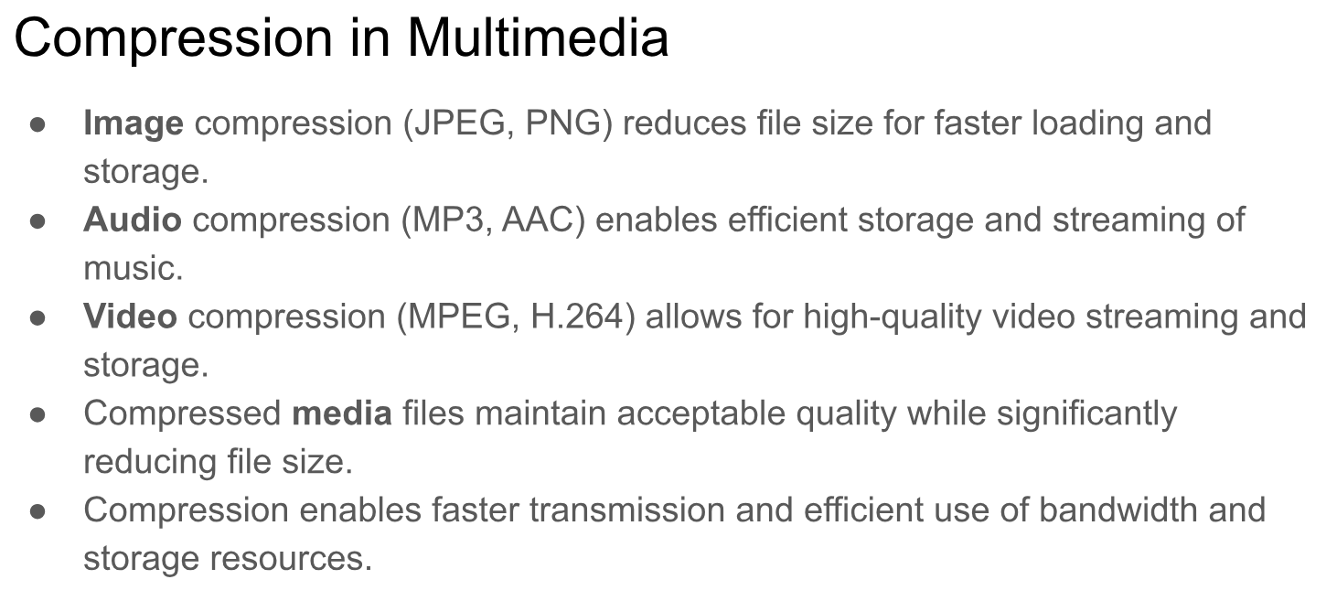

Slide 13
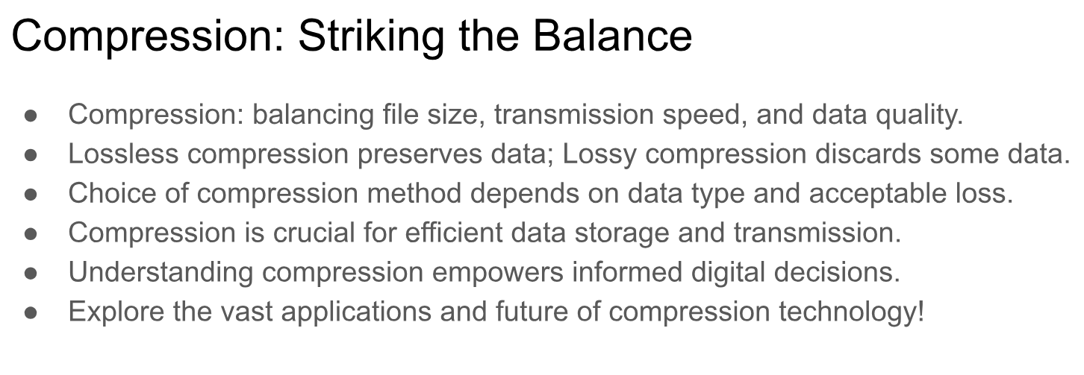

Slide 14
GROUP TASK
LEVEL 1 : Table 1/4
Explain the advantages and disadvantages of each compression method, considering factors like file size, quality, and application.
LEVEL 2 : Table 2 / 3
Present a case study of how compression is used in a specific application or industry (e.g., video streaming, digital photography, data storage). Discuss the challenges and trade-offs involved in choosing appropriate compression techniques

Slide 15
Evaluate (5 minutes)
Students write a short reflection on the following prompt: "How does understanding compression impact your choices as a consumer and user of technology?" This encourages students to connect their learning to real-world decisions.

